Slide 1
Turmeric - UKON
by Antonina Bureacenco
Notes:
Water the Great Mystery documentary https://www.youtube.com/watch?v=PyP0KOHkqpo

Slide 2
Why Turmeric
5600 Peer- Reviewed and published Biomedical Studies
600 Reasons Turmeric May Be The World's Most Important Herb
Five-year long research project on this sacred plant has revealed over 600 potential preventive and therapeutic applications, as well as 175 distinct beneficial physiological effects

Slide 3
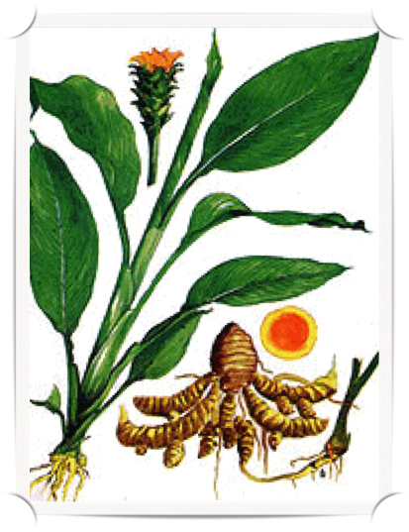
Side Benefits…
“Turmeric turns the entire drug-based medical model on its head…
Instead of causing far more side effects than therapeutic ones, as is the case for most patented pharmaceutical medications, turmeric possesses hundreds of potential side benefits, having been empirically demonstrated to positively modulate over 160 different physiological pathways in the mammalian body." - Sayer Ji

Slide 4
600 Reasons Turmeric May Be The
World's Most Important Herb
Some of the most amazing demonstrated properties include:
• Destroying Multi-Drug Resistant Cancer
• Destroying Cancer Stem Cells (arguably, the root of all cancer)
• Protecting Against Radiation-Induced Damage
• Reducing Unhealthy Levels of Inflammation
• Protecting Against Heavy Metal Toxicity
• Preventing and Reversing Alzheimer's Disease Associated Pathologies

Slide 5
Turmeric vs. Medications
Science Confirms Turmeric As Effective As 14 Drugs
Notes:
Water the Great Mystery documentary https://www.youtube.com/watch?v=PyP0KOHkqpo

Slide 6
Corticosteroids
(steroid medications)
A 1999 study published in the journal Phytotherapy Research found that the primary polyphenol in turmeric, the saffron colored pigment known as curcumin, compared favorably to steroids in the management of chronic anterior uveitis, an inflammatory eye disease.[ii] A 2008 study published in Critical Care Medicine found that curcumin compared favorably to the corticosteroid drug dexamethasone in the animal model as an alternative therapy for protecting lung transplantation-associated injury by down-regulating inflammatory genes.[iii] An earlier 2003 study published in Cancer Letters found the same drug also compared favorably to dexamethasone in a lung ischaemia-repurfusion injury model.[iv] [for additional curcumin and inflammation research – 52 abstracts]

Slide 7
Lipitor/Atorvastatin
(cholesterol medication)
A 2008 study published in the journal Drugs in R & D found that a standardized preparation of curcuminoids from Turmeric compared favorably to the drug atorvastatin (trade name Lipitor) on endothelial dysfunction, the underlying pathology of the blood vessels that drives atherosclerosis, in association with reductions in inflammation and oxidative stress in type 2 diabetic patients. [i] [For addition curcumin and 'high cholesterol' research – 8 abstracts]

Slide 8
Prozac/Fluoxetine & Imipramine
(antidepressants)
A 2011 study published in the journal Acta Poloniae Pharmaceutica found that curcumin compared favorably to both drugs in reducing depressive behavior in an animal model.[v] [for additional curcumin and depression research – 5 abstracts]

Slide 9
Aspirin
(blood thinner)
A 1986 in vitro and ex vivo study published in the journal Arzneimittelforschung found that curcumin has anti-platelet and prostacyclin modulating effects compared to aspirin, indicating it may have value in patients prone to vascular thrombosis and requiring anti-arthritis therapy.[vi] [for additional curcumin and anti-platelet research]

Slide 10
Metformin
(diabetes drug)
A 2009 study published in the journal Biochemitry and Biophysical Research Community explored how curcumin might be valuable in treating diabetes, finding that it activates AMPK (which increases glucose uptake) and suppresses gluconeogenic gene expression (which suppresses glucose production in the liver) in hepatoma cells. Interestingly, they found curcumin to be 500 times to 100,000 times (in the form known as tetrahydrocurcuminoids(THC)) more potent than metformin in activating AMPK and its downstream target acetyl-CoA carboxylase (ACC). [ix]

Slide 11
Anti-inflammatory Drugs
A 2004 study published in the journal Oncogene found that curcumin (as well as resveratrol) were effective alternatives to the drugs aspirin, ibuprofen, sulindac, phenylbutazone, naproxen, indomethacin, diclofenac, dexamethasone, celecoxib, and tamoxifen in exerting anti-inflammatory and anti-proliferative activity against tumor cells.[vii] [for additional curcumin and anti-proliferative research – 15 abstracts]

Slide 12
Oxaliplatin
(chemotherapy drug)
A 2007 study published in the International Journal of Cancer found that curcumin compares favorably with oxaliplatin as an antiproliferative agenet in colorectal cell lines.[viii] [for additional curcumin and colorectal cancer research – 52 abstracts]

Slide 13
Cancer
Another way in which turmeric and its components reveal their remarkable therapeutic properties is in research on drug resistant- and multi-drug resistant cancers. We have two sections on our site dedicated to researching natural and integrative therapies on these topics, and while there are dozens of substances with demonstrable efficacy against these chemotherapy- and radiation-resistant cancers, curcumin tops both lists:
• Cancers: Drug Resistant
• Cancers: Multi-Drug Resistant
We have found no less than 54 studies indicating that curcumin can induce cell death or sensitize drug-resistant cancer cell lines to conventional treatment.[x]
We have identified 27 studies on curcumin's ability to either induce cell death or sensitize multi-drug resistant cancer cell lines to conventional treatment.[xi]
Considering how strong a track record turmeric (curcumin) has, having been used as both food and medicine in a wide range of cultures, for thousands of years, a strong argument can be made for using curcumin as a drug alternative or adjuvant in cancer treatment.

Slide 14
Resources
• [i] P Usharani, A A Mateen, M U R Naidu, Y S N Raju, Naval Chandra. Effect of NCB-02, atorvastatin and placebo on endothelial function, oxidative stress and inflammatory markers in patients with type 2 diabetes mellitus: a randomized, parallel-group, placebo-controlled, 8-week study. Drugs R D. 2008;9(4):243-50. PMID: 18588355
• [ii] B Lal, A K Kapoor, O P Asthana, P K Agrawal, R Prasad, P Kumar, R C Srimal. Efficacy of curcumin in the management of chronic anterior uveitis. Phytother Res. 1999 Jun;13(4):318-22. PMID: 10404539
• [iii] Jiayuan Sun, Weigang Guo, Yong Ben, Jinjun Jiang, Changjun Tan, Zude Xu, Xiangdong Wang, Chunxue Bai. Preventive effects of curcumin and dexamethasone on lung transplantation-associated lung injury in rats. Crit Care Med. 2008 Apr;36(4):1205-13. PMID: 18379247
• [iv] J Sun, D Yang, S Li, Z Xu, X Wang, C Bai. Effects of curcumin or dexamethasone on lung ischaemia-reperfusion injury in rats. Cancer Lett. 2003 Mar 31;192(2):145-9. PMID: 18799504
• [v] Jayesh Sanmukhani, Ashish Anovadiya, Chandrabhanu B Tripathi. Evaluation of antidepressant like activity of curcumin and its combination with fluoxetine and imipramine: an acute and chronic study. Acta Pol Pharm. 2011 Sep-Oct;68(5):769-75. PMID: 21928724
• [vi] R Srivastava, V Puri, R C Srimal, B N Dhawan. Effect of curcumin on platelet aggregation and vascular prostacyclin synthesis. Arzneimittelforschung. 1986 Apr;36(4):715-7. PMID: 3521617
• [vii] Yasunari Takada, Anjana Bhardwaj, Pravin Potdar, Bharat B Aggarwal. Nonsteroidal anti-inflammatory agents differ in their ability to suppress NF-kappaB activation, inhibition of expression of cyclooxygenase-2 and cyclin D1, and abrogation of tumor cell proliferation. Oncogene. 2004 Dec 9;23(57):9247-58. PMID: 15489888
• [viii] Lynne M Howells, Anita Mitra, Margaret M Manson. Comparison of oxaliplatin- and curcumin-mediated antiproliferative effects in colorectal cell lines. Int J Cancer. 2007 Jul 1;121(1):175-83. PMID: 17330230
• [ix] Teayoun Kim, Jessica Davis, Albert J Zhang, Xiaoming He, Suresh T Mathews. Curcumin activates AMPK and suppresses gluconeogenic gene expression in hepatoma cells. Biochem Biophys Res Commun. 2009 Oct 16;388(2):377-82. Epub 2009 Aug 8. PMID: 19665995
• [x] GreenMedInfo.com, Curcumin Kills Drug Resistant Cancers, 54 Abstracts
• [xi] GreenMedInfo.com, Curcumin Kills Multi-Drug Resistant Cancers: 27 Abstracts.

Slide 15
Traditional Usage
of Turmeric
From ancient times, turmeric has been used by traditional herbal practitioners in South/South East Asia.
“Ukon” is the Japanese name for Turmeric-like plants which
is a major spice in Asian countries
is a perennial plant of the ginger family
is native to tropical South Asia
Traditional Usage:
freshly use of the rhizomes (root stock) and leaf
the rhizomes are boiled, dried, ground into a powder for spice, food additives, dyeing, crude drugs, etc.
the essential oil of turmeric is used in perfumes, and its resin is used as a flavour and color component in foods.

Slide 16
Dietary Supplement
Prevention is Key!
Notes:
Water the Great Mystery documentary https://www.youtube.com/watch?v=PyP0KOHkqpo
Supplementation

Slide 17
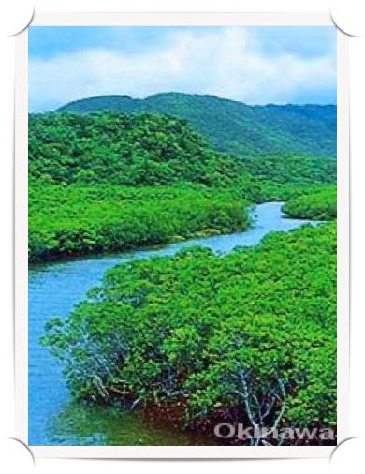
Advantages of Growing Turmeric in Okinawa…
CLIMATE: Subtropical, High Humidity, High Temperatures (need 20-30C or 68-86F), Long Durations of Sun Exposure
SOIL: Fertile and Well Drained
LAND: Good Water Supply (due to the coral islands and typhoons)
CULTIVATOR: 107 Contracted Farmers

Slide 18
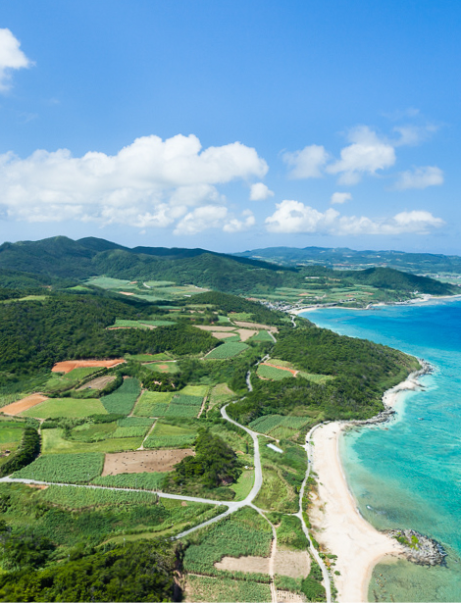
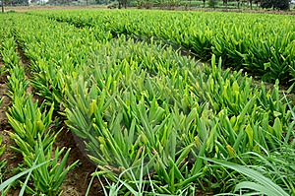
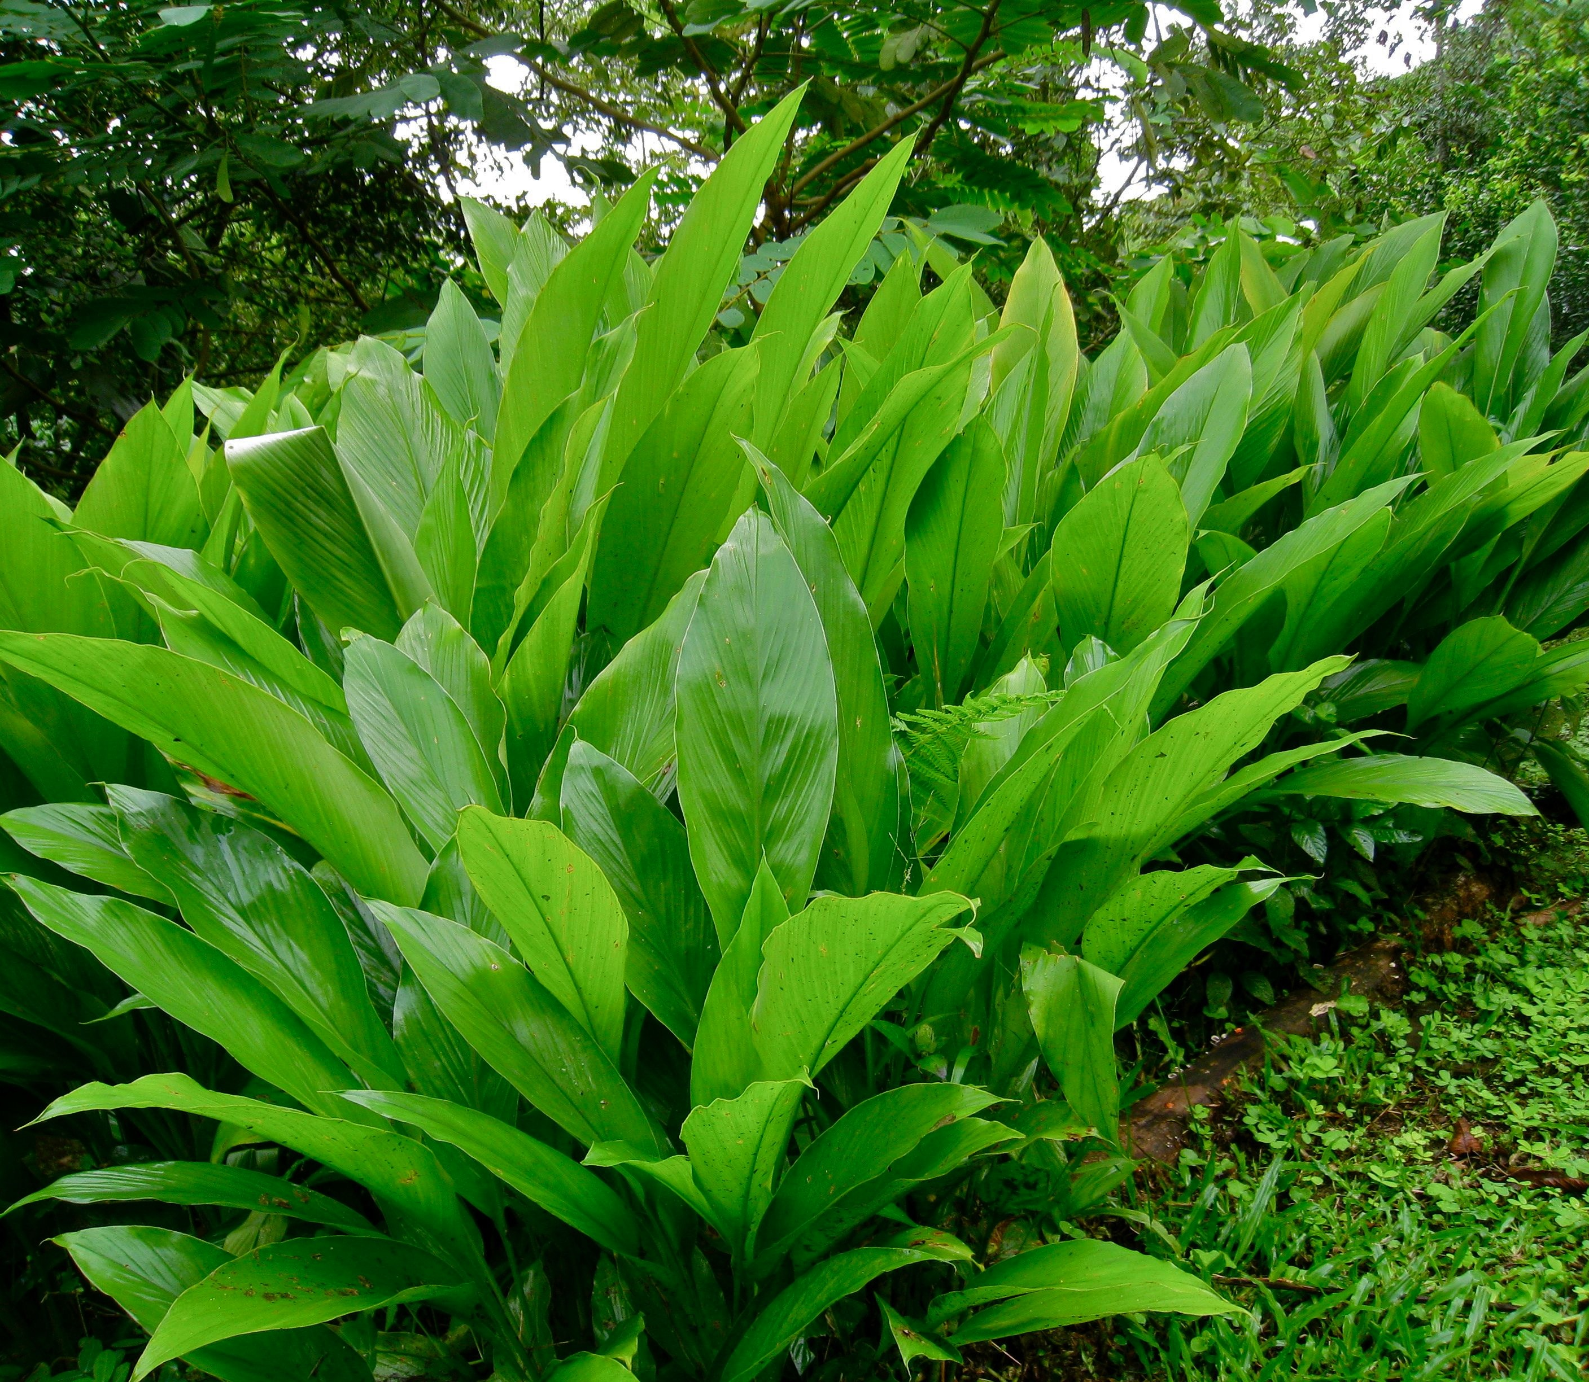

Slide 19
Organic Fertilizer
Made by Enagic
Notes:
Water the Great Mystery documentary https://www.youtube.com/watch?v=PyP0KOHkqpo
Supplementation

Slide 20
Our Kangen Ukon contains more Ukon essential Oils than ever!
All ingredients are 100% plant-based. This product is vegan-friendly as there are no animal products used.
Dr. Shuichi Mizuno, M.D., a well-known Noted herbal medicine researcher describes Ukon in his book “Kanjin Kanameno Ukon to Gajutsu” (Essential Point of Turmeric and Zedoary), published Dec 1, 1998, page62:
“The quality of Ukon is largely related to the quality of cultivated land. The growth of Ukon requires well drained and rich, organic soil. Soil in the northern part of Okinawa is said to be the best soil. The reason why the soil there is the best is because it contains rich calcium from corals and shells, and the soil is well drained”.
Yanbaru (Northern part of Okinawa) is often called “natures treasures”. Spring upon (harvested exclusively for Enagic) is originally grown on dedicated farms in Yanbaru and 100% free of the harmful chemicals used in conventional farming.
Spring Ukon and Autumn Ukon are cleansed and sanitized by Strong Kangen Water (11.5ph) and Strong Acidic Water (2.5ph) at the Enagic Foods Co. factory. It is the first supplement ever produced by combination of curcumin and 100% addictive free Spring Ukon essential oils.
Our patented 100% plant based soft gel Kangen Ukon capsule is made complete with antioxidant ingratiates such as olive oil, perilla oil, and flaxseed oil and tocotrienol.
In addition, carrageenan, a see weed derivative, is used as an ingredient for the coating of the capsule.

Slide 21
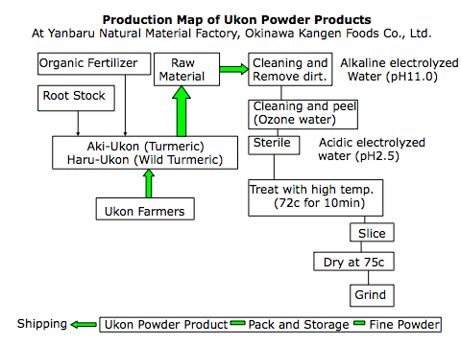

Slide 22
Spring & Fall Turmeric
AKI-UKON (aka Fall Turmeric, Curcuma longa). Traditionally used for curry and as a herbal medicine. Rich in Curcumin, contains 9x more curcumin than Haru.
HARU-UKON (aka Spring or Wild Turmeric, Curcuma armartica). Healthy food and herbal medicine rich in essential oils and minerals. Rich in essential oils, contains 9x more minerals than Aki.

Slide 23
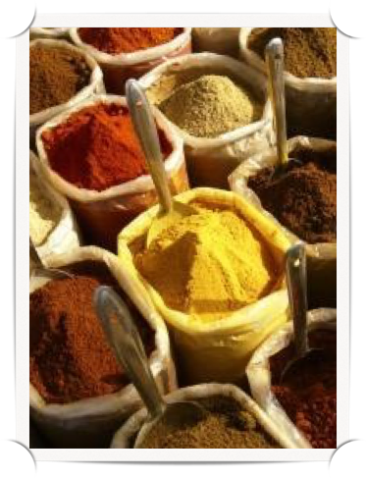
Main Ingredients of Kangen UKON
Spring Ukon (wild turmeric) powder:
Contains curcumin and many minerals including calcium, potassium, magnesium, iron, zinc, manganese, prosperous and selenium.
Autumn Ukon (turmeric) powder:
Contains minerals and high amount of curcumin. Curcumin works as an antioxidant to scavenge free radicals that can be damaging to cells and DNA.
Olive Oil, Perrila Oil, Flaxseed Oil
Tocatrienol a member of a Vitamin E family contained in rice plants. It is often called “Super Vitamin E” due to its antioxidant effects.
Spring Ukon Oil contains a variety of essential oils curcumin, turmerone, cineol, cuecumol, azulene, camphor, and flavanoid.
Niacine (nicotinamide) promotes healthy skin and healthy liver function.
Evening Primrose Oil help montain cholesterol and blood sugar.

Slide 24
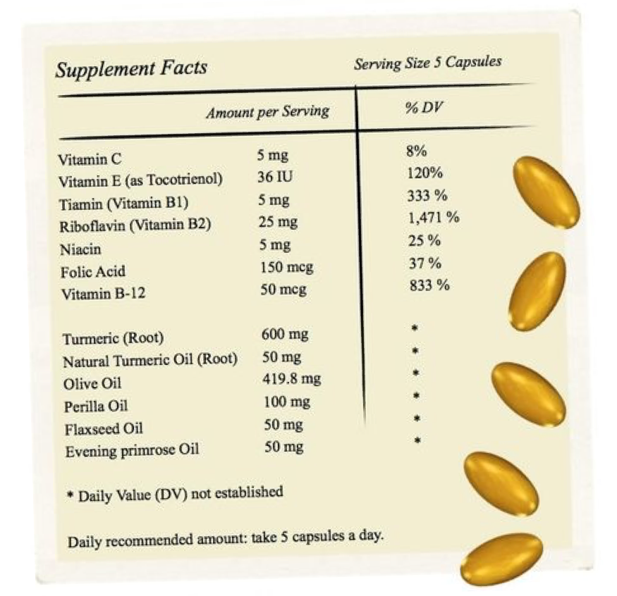

Slide 25
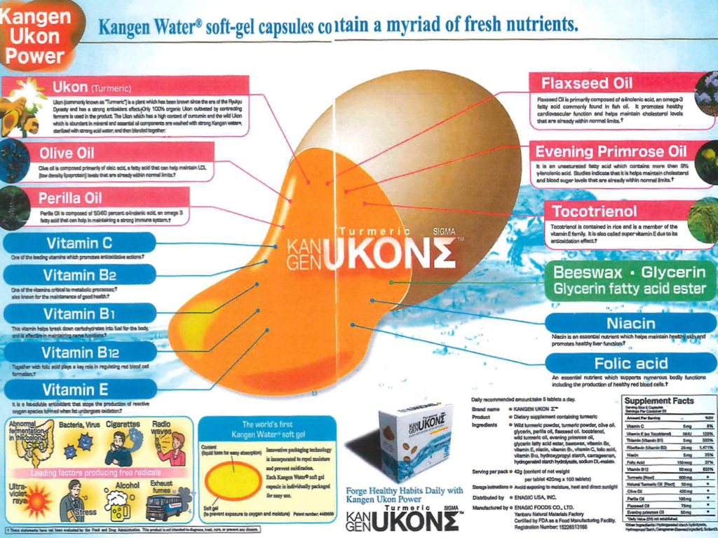

Slide 26
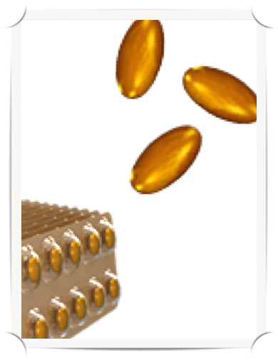
UKON Gel Capsule
CONTENT: liquid form for easy absorption
INNOVATIVE PACKAGING: technology is incorporated to repel moisture and prevent oxidation. Each is packaged separately for easy use.
SOFT GEL: prevents exposure to oxygen and moisture, patent number 4469660

